Slide 1



Shri Kiritbhai D. Patel Umiya B.C.A College

Slide 2


Welcome to
Online beauty
shopping

Slide 3
Our Team...
Thakor Usmita
Roll No:116
Rathod Khushbu
Roll No:104
Valmiki Dipika
Roll No:26

Slide 4
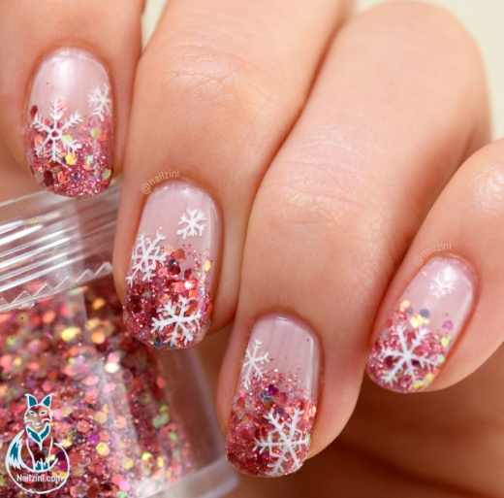


Internal Guide :
Dhruvi suthar

Slide 5


...Company Details...
In House

Slide 6
Index
Our Company
Project Profile
Tools
Existing System
Proposed System
Categories
Users
Modules
System Flow Diagram
Use case Diagram
Class Diagram
Activity Diagram
Sequence Diagram
State chart Diagram

Slide 7

Our Company
Our project is Working On
Online Beauty shopping.
“Beauty shopping” is website
provides Beauty product.

Slide 8
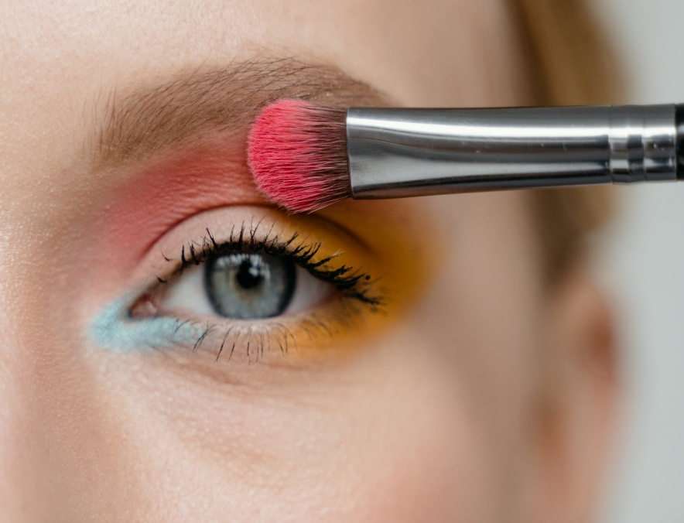
Project Profile
Project Name:
Beauty Bunch
Front-end Language:
HTML5, CSS3, JS,PHP8.2
Back-end
MySQLi Database

Slide 9



Tools
Development Tool | VS Code(Editor)
Development Supporting Software | XAMPP
H/W requirement for better performance. | Min 2GB RAM 124 GB Hard Disk
S/W Requirement for better performance. | MySQL

Slide 10


EXISTING SYSTEM :
Till now the company was selling the products
offline to the customers.
Customer details were maintained on paper.
Company don’t have any online platform for
selling the Products.

Slide 11


PROPOSED SYSTEM :
User can search product.
The system will contain all the items in one place, so users need not
to go the different shops
This will reduce the time consumption in the purchase of different items,
make the system efficient and user friendly.
A user can choose from the different products ,can make online
payments and Will get the products at the doorsteps.
User will get related product result.

Slide 12


Categories
Makeup:
Foundation,Compact,Eyeliner,
Eyeshadow,Nailpolish
Skincare:
Facewash,Scrub,Sheetmask,
Sunscreen
Hair care:
Shampoo,Conditioner,Hair mask

Slide 13




Users
Admin
Customers
ADMIN CAN ACCESS EACH AND
EVERY PART OF WEBSITE
CUSTOMER CAN LOGIN INTO
A WEBSITE AND HE/SHE CAN
BUY ANY BEAUTY PRODUCTS ON THE WEBSITE .
Delivery
Visitors
DELIVERY BOY/GIRL
WILL DELIVER YOUR PRODUCT ON
YOUR DOORSTEP
VISITORS CAN VISIT THE
WEBSITE

Slide 14

Modules:
Login/Registration:-
Order Management:-
Admin Can Login into System.
User have to Compulsory Register & Login.
Customer can add or remove or Cancel order.
Admin Can Manage the Order Of the Customers.
Payment Management:-
Search Products:-
Customer can pay the bill through payment method.
(Online or Cash on Delivery)
User can search different types of Products.
Buy searching the particular Product you can also get similar and related products records.

Slide 15
Modules:
Buy Products:-
Category:-
User can buy the Product from this application/website.
By searching a specific product user can get records.
Admin can manage category.
User can select specific category from category list.
Sub-Category:-
Add To Cart:-
Admin can manage sub-category .
Sub-categories are divisions of items within a category.
When user will select the order they will directly stores in add to cart.

Slide 16


System Flow Diagram:-

Slide 17
Symbols of system flow Diagram:
Symbols | Name | Description
 | Start/End Terminator | An oval represents a start or end point
 | Process | A rectangle represents a process
 | Desicion | A dimond indicates a decision
 | Arrow | A line is a connector that shows relationships between the representative shapes

Slide 18
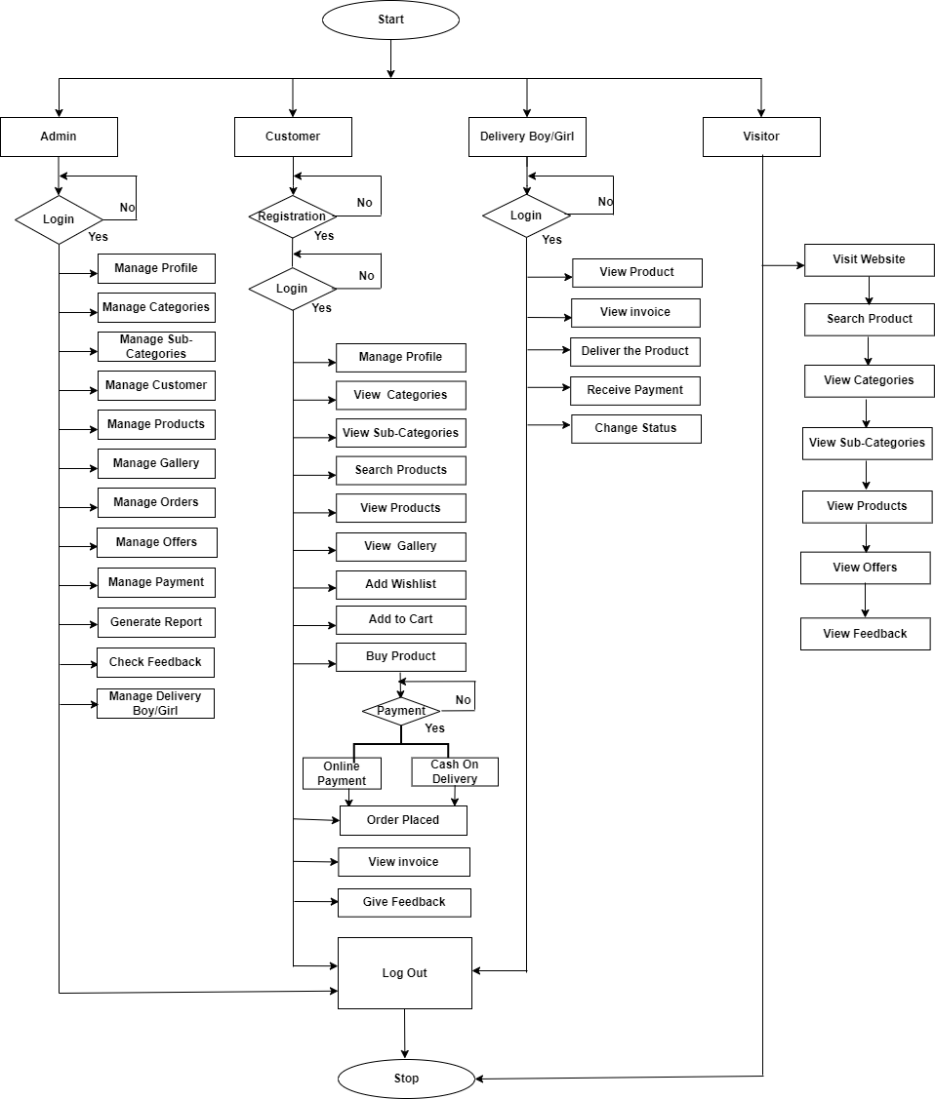

Slide 19
Use-case Diagram:-

Slide 20
Symbols of Use-case Diagram:
Use-Case
System Boundary
Actor
Relationship

Slide 21
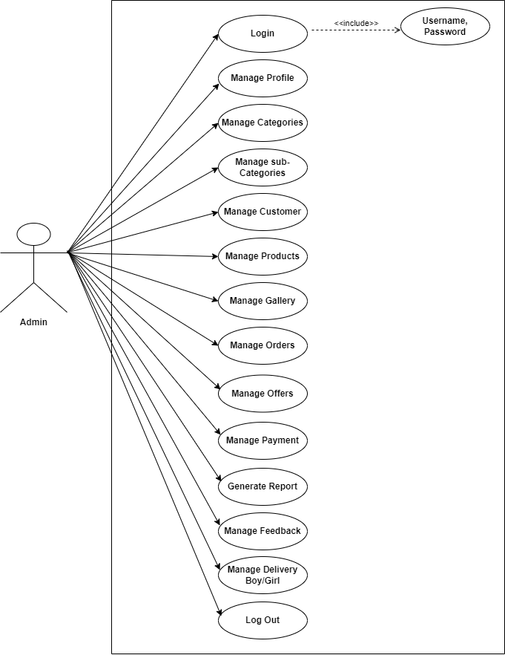

Admin Usecase Diagram

Slide 22
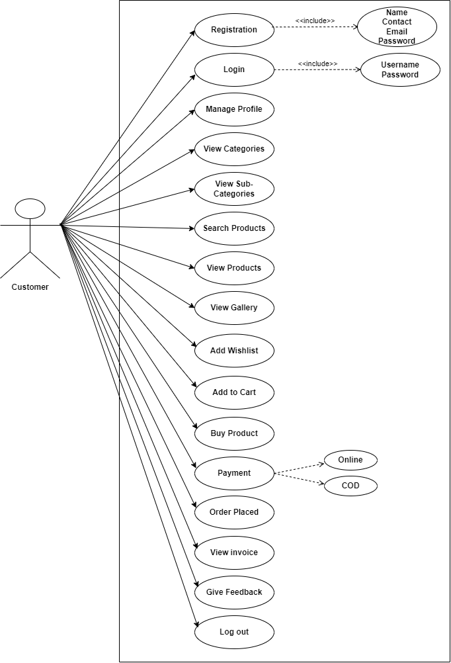
Customer Usecase Diagram

Slide 23
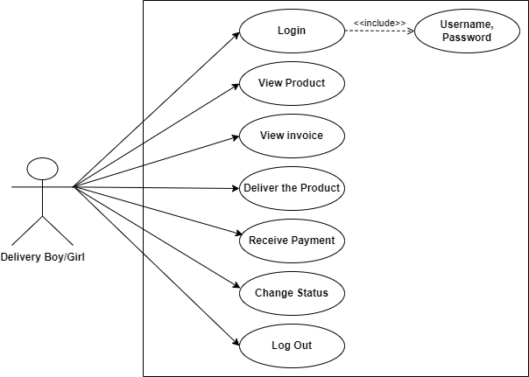
Delivery Boy/Girl Usecase Diagram

Slide 24
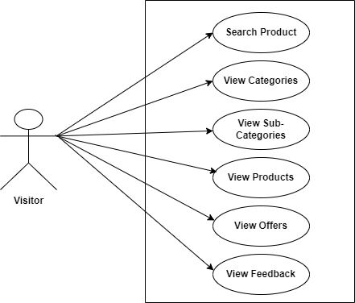
Visitor Usecase Diagram

Slide 25
Class Diagram:-

Slide 26
Symbols of class Diagram:
Class
Package
Interface
Generalization

Slide 27
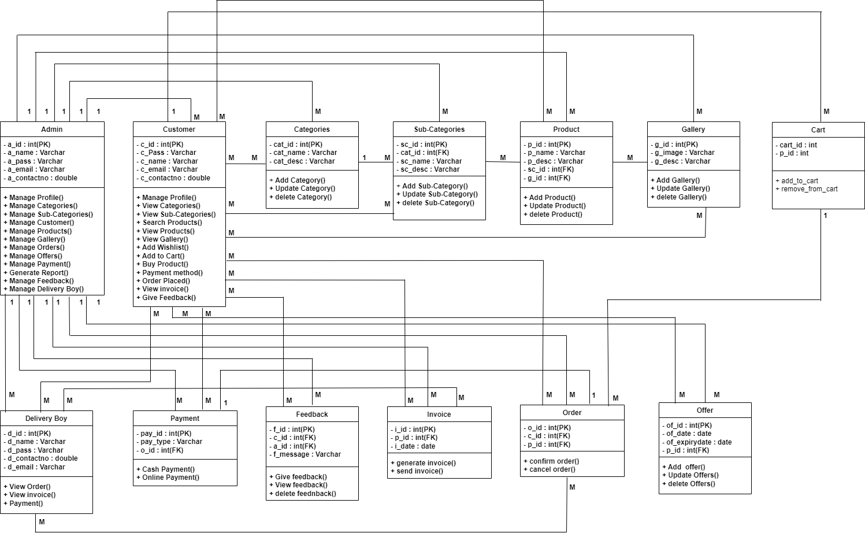
Class Diagram

Slide 28
Activity Diagram:-

Slide 29
Symbols of Activity Diagram:
Decision
Initial State
Swimlane
State(action)
Fork
Final State
Transition
Join

Slide 30
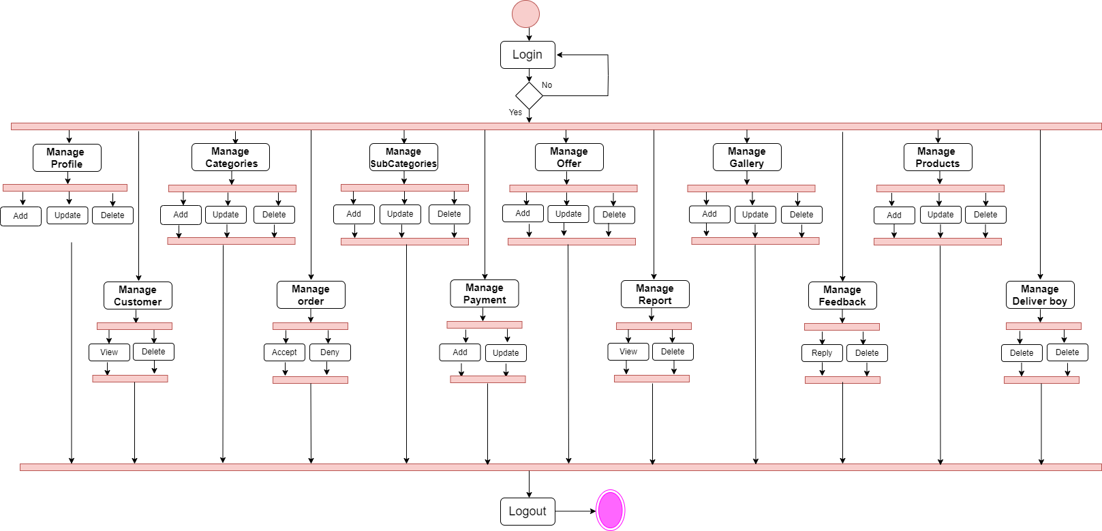
Admin Activity Diagram

Slide 31
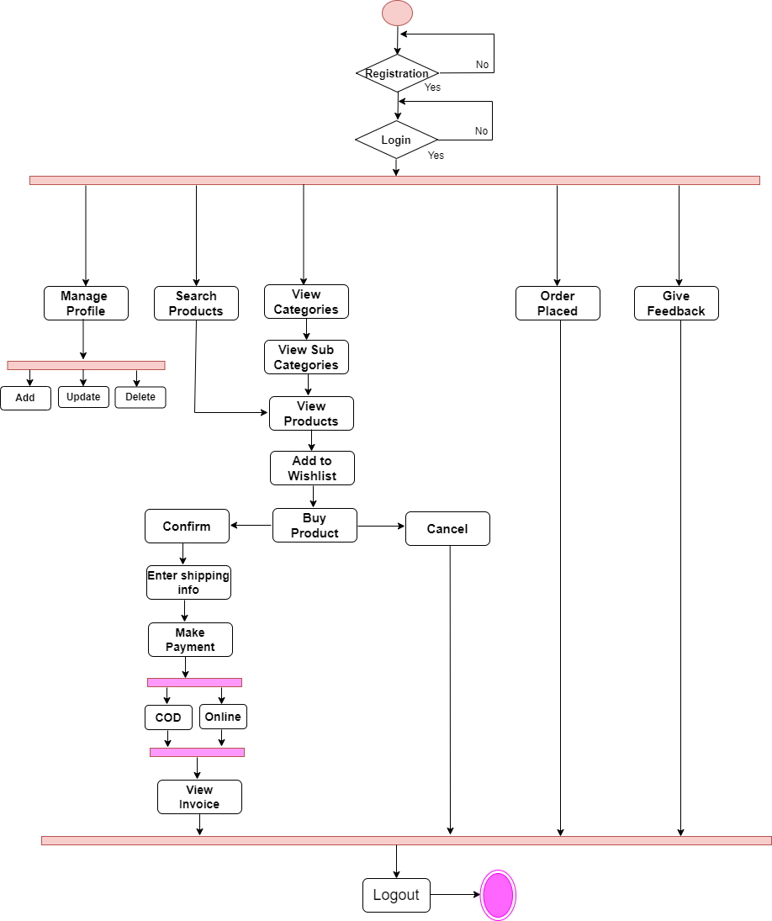
Customer Activity Diagram

Slide 32
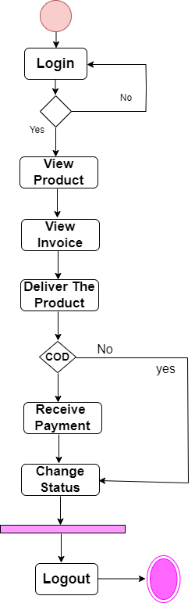
Delivery Boy/Girl Activity Diagram

Slide 33
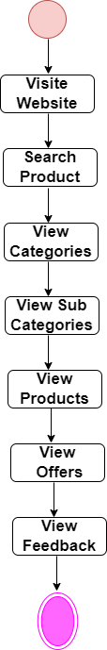
Visitor Activity Diagram

Slide 34
Sequence Diagram:-

Slide 35
Symbols of Sequence Diagram:
Actor
Boundary
Control
Entity
Return Message
Execution Specification

Slide 36
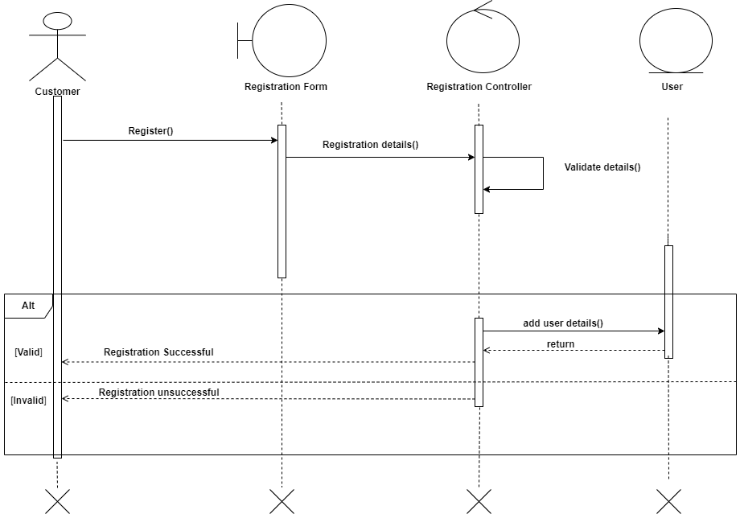
Registration

Slide 37
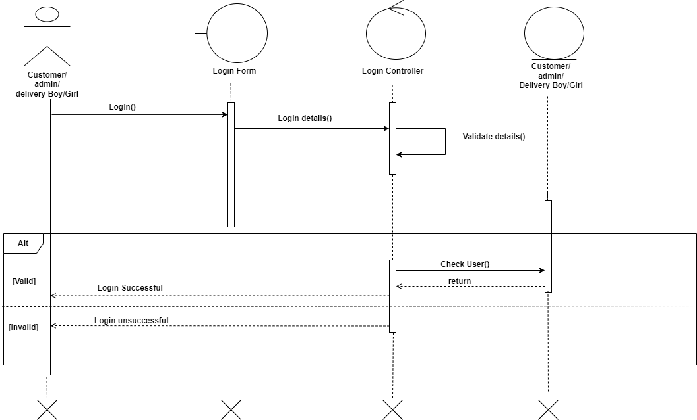
Login

Slide 38
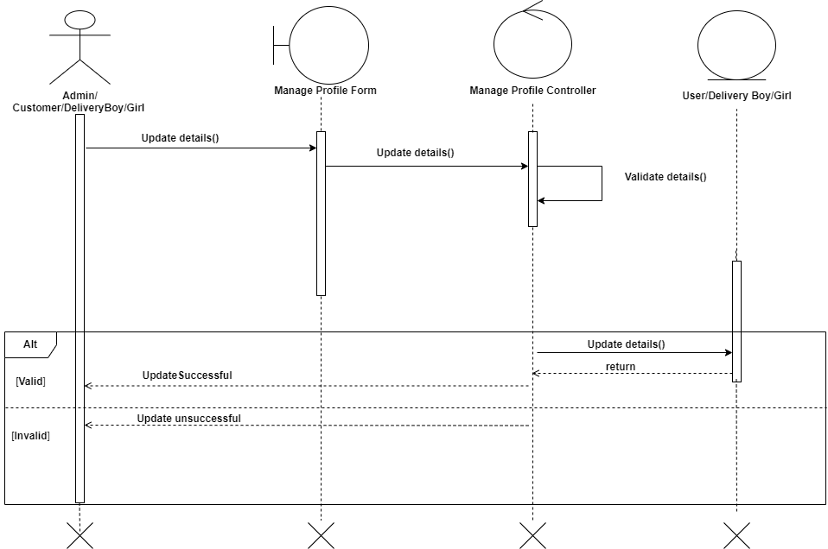
Manage Profile

Slide 39
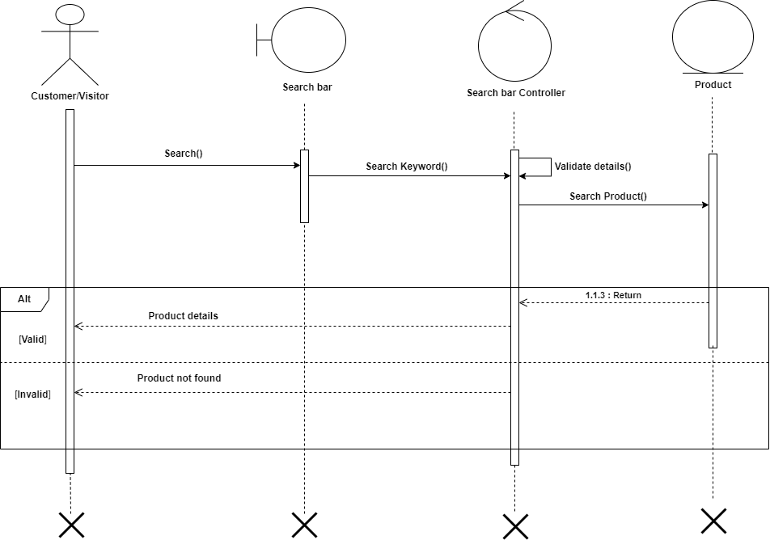
Search Product

Slide 40
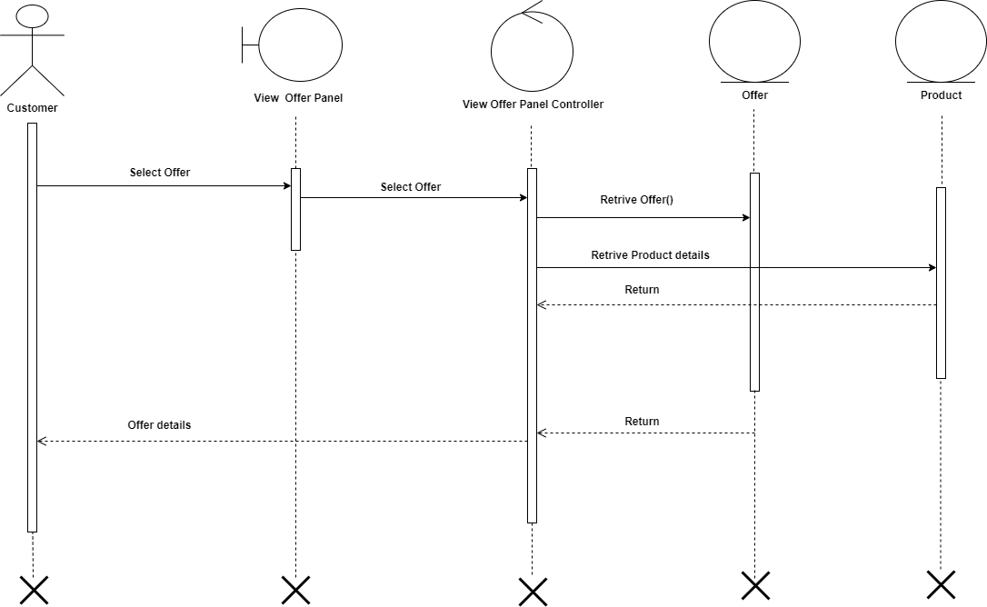
View Offer

Slide 41
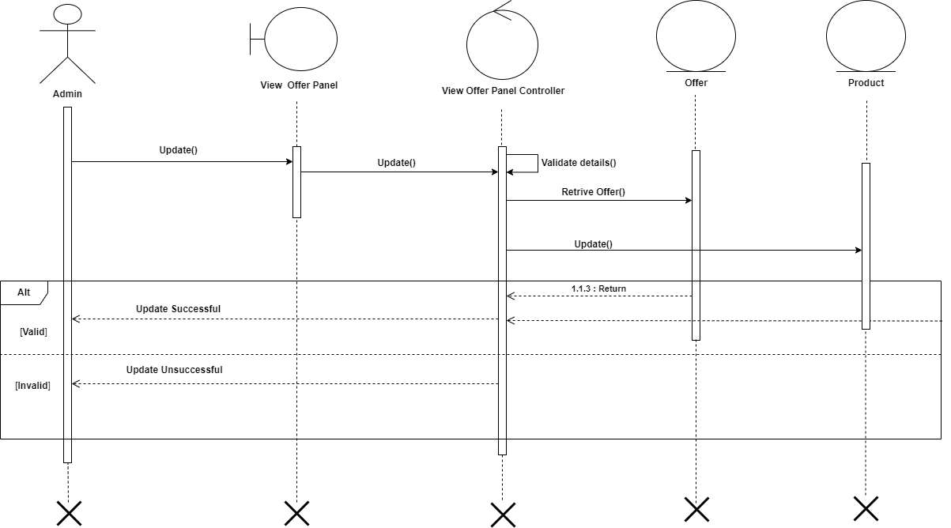
Manage Offer

Slide 42
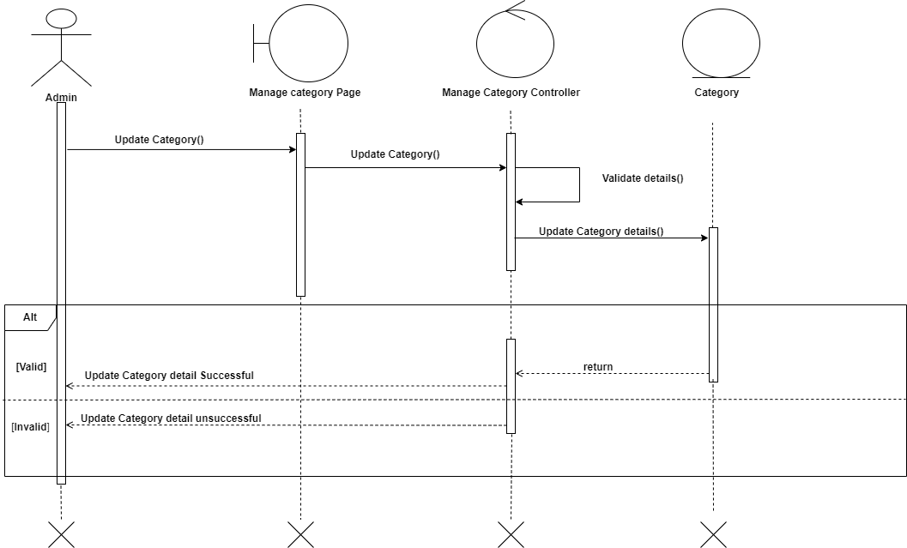
Manage Category

Slide 43

Manage Sub-Category

Slide 44
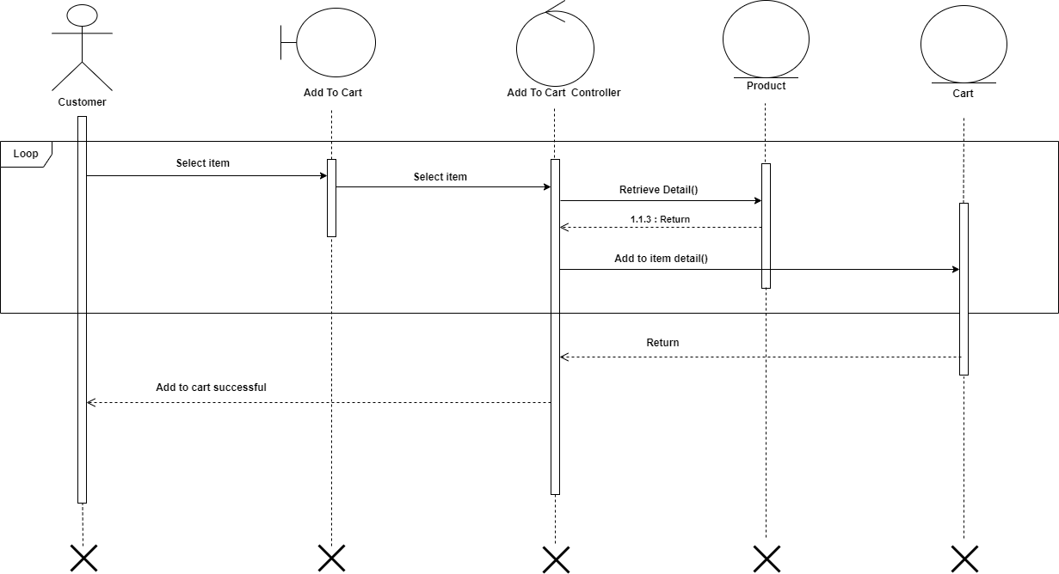
Add To Cart

Slide 45
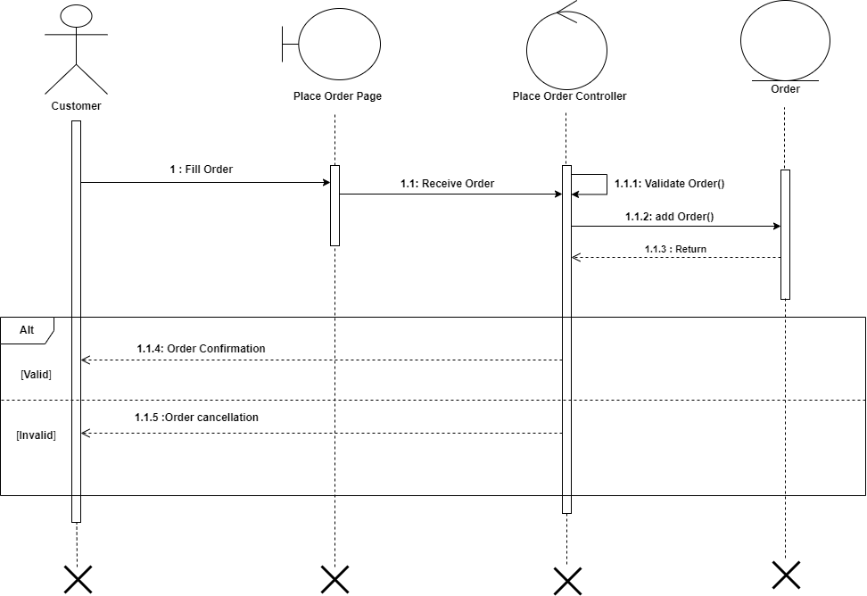
Place Order

Slide 46
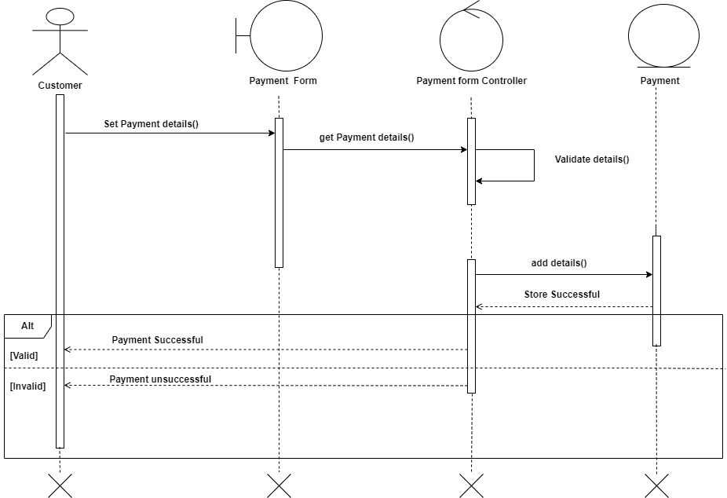
Payment

Slide 47
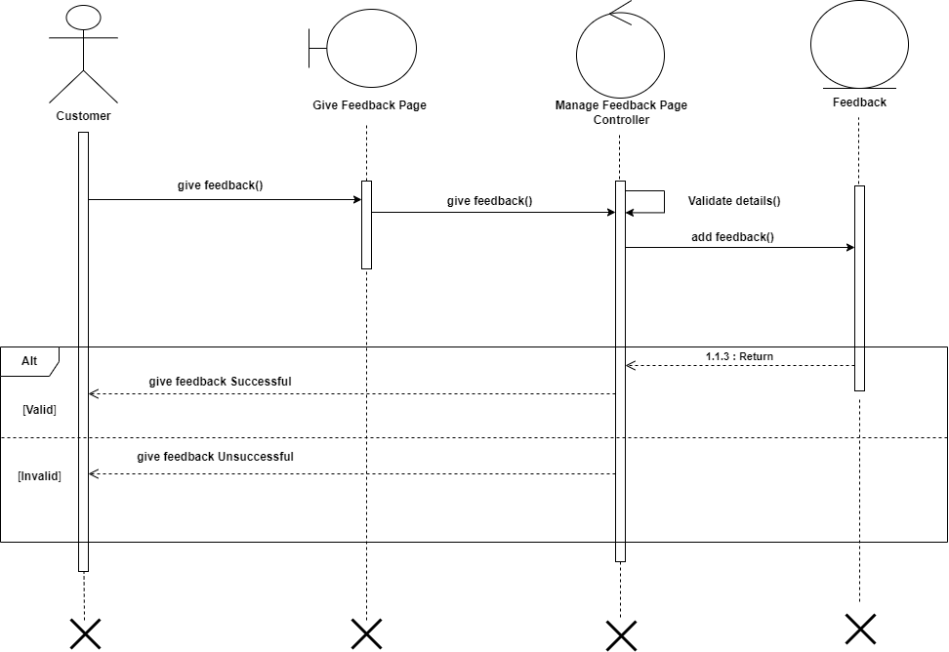
Give Feedback

Slide 48
State-chart Diagram:-

Slide 49
Symbols of State-chart Diagram:
Initial State
Transition
State(action)
Final State

Slide 50
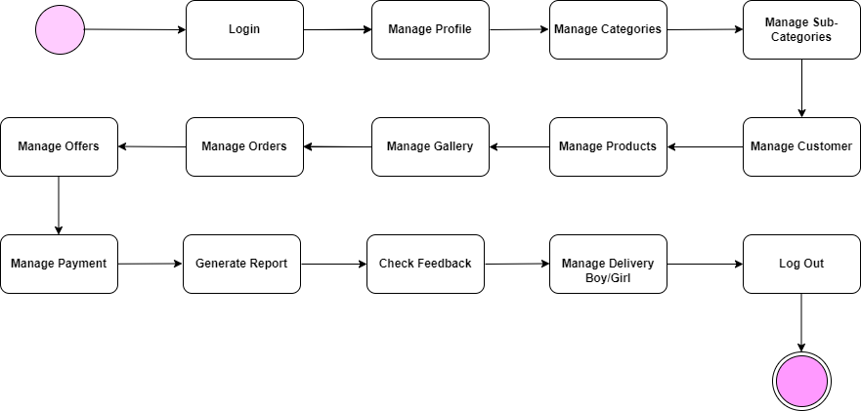
Admin State-Chart diagram

Slide 51
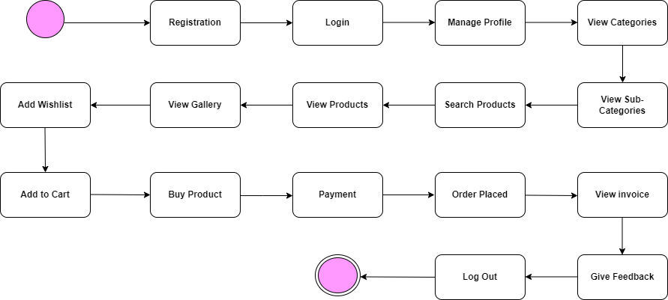
Customer State-Chart diagram

Slide 52
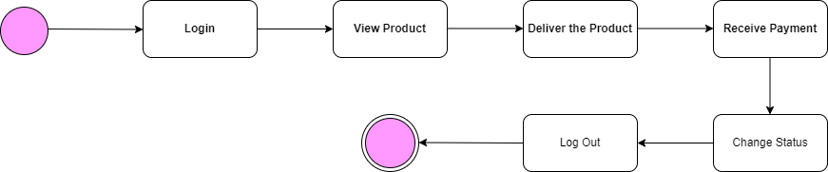
DeliveryBoy/Girl State-Chart diagram

Slide 53
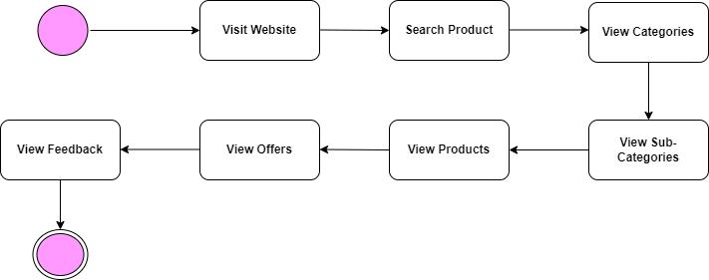
Visitor State-Chart diagram

Slide 54

Thank
You

